Slide 1
MSc Software Development
CSC7061 - Programming
Selection statements
If, If Else & Switch

Slide 2

Content
Keywords
Selection statements, if, if else, switch, case, break, condition, expression.
Understanding and Equality and Relational operators
Understanding and use of Java’s main selection statements, including the if, if else, else if, logical operators, and switch statements.
Understanding and use of Logical operators.
What you will learn

Slide 3

Making decisions
Selection statements in Java allow you to make decisions in your code based on certain conditions. Java provides two primary selection statements: the "if" statement (and variations) and the "switch" statement. These statements help you control the flow of your program by executing different blocks of code based on whether certain conditions are met.
if statement : single selection
if .. else statement : double selection
switch statement : multiple selection
Notes:
Software Development

Slide 4

Equality and Relational Operators
A condition is an expression that can be true or false. This section introduces Java’s if selection statement, which allows a program to make a decision based on a condition’s value. For example, the condition “grade is greater than or equal to 50” determines whether a student passed the MSc.
If the condition in an if statement is true, the body of the if statement executes. If the condition is false, the body does not execute.
Conditions in if statements can be formed by using the equality operators (== and !=) and relational operators (>, <, >= and <=)
== equal to
!= not equal to
> greater than
>= greater than or equal to
< less than
<= less than or equal to

Slide 5
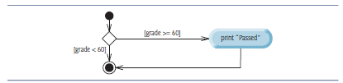
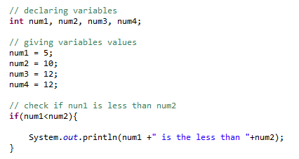
if Single-Selection Statement
Programs use selection statements to choose among alternative courses of action.
For example, suppose that the passing grade on an exam is 60. The pseudocode statement determines whether the condition “student’s grade is greater than or equal to 60” is true.
Evaluates to true
If body is executed

Slide 6
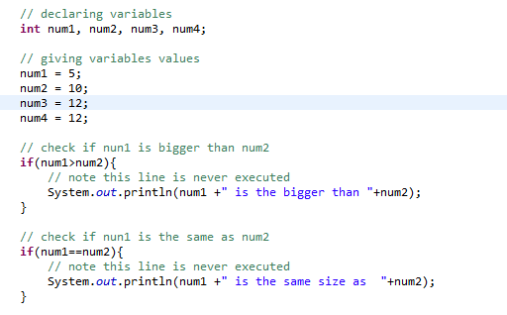

if Single-Selection Statement
Evaluates to false
If body NOT executed
Common error - confusing the equality operator == with the assignment operator = can cause a logic error or a syntax error.
Read the equality operator should be as “is equal to” Read the assignment operator as “gets” or “gets the value of.”

Slide 7
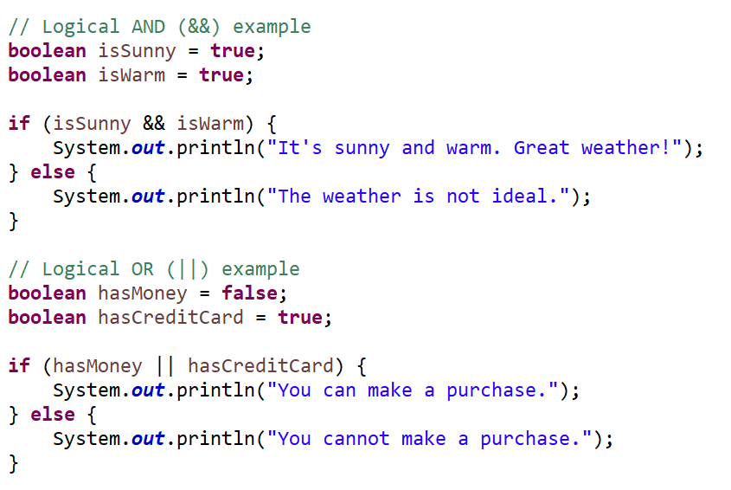
Logical operators
Enables the testing of multiple conditions in the process of making a decision.
Java’s logical operators enable you to form more complex conditions by combining simple conditions.
&& Conditional-AND
|| Conditional-OR
?: Ternary (shorthand for if-then-else statement)
If both isSunny and isWarm are true, the program prints that it's great weather. Otherwise, it indicates that the weather is not ideal.
If either hasMoney or hasCreditCard is true, the program prints that you can make a purchase. Otherwise, it indicates that you cannot make a purchase.

Slide 8

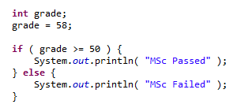
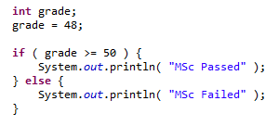
if .. else Statement
The if single-selection statement performs an indicated action only when the condition is true; otherwise, the action is skipped.
The if…else double-selection statement allows you to specify an action to perform when the condition is true and a different action when the condition is false.
MSc Passed
MSc Failed

Slide 9


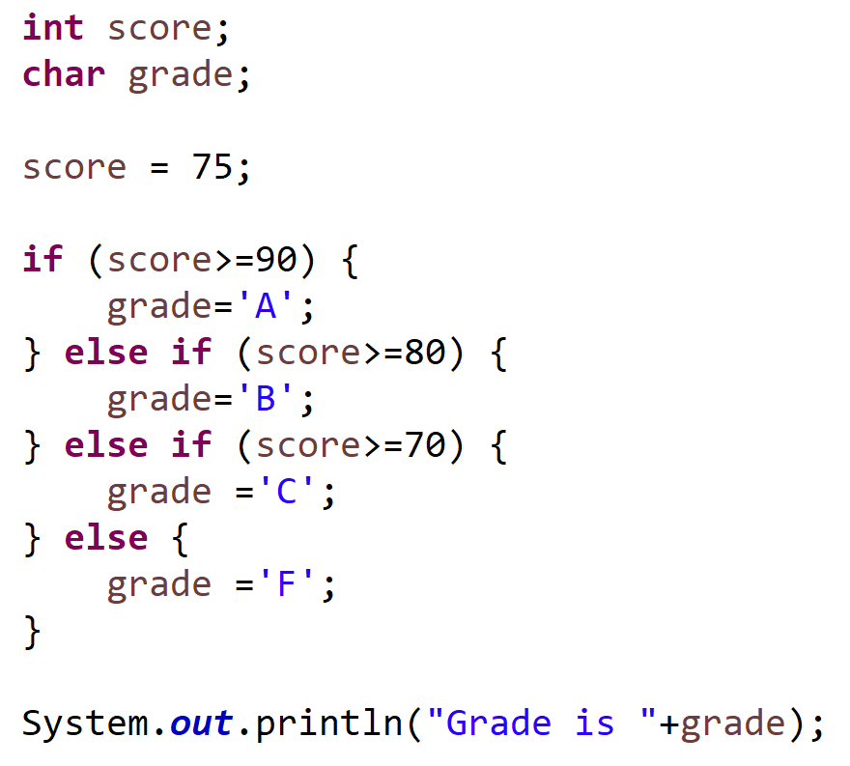
if … else if Statements
Test multiple cases by placing if…else statements inside other if…else statements to create if…else if statements
Grade is C

Slide 10



Exercise I: if .. else and logical operators
Create an application that will output a message when the credit history and age of an applicant is processed. Rules: to be successful the applicant must be 18 years old or over and have a good credit history.
Hints : two vars needed age (int) and goodCreditHistory (boolean)
Exercise II: if .. else if
Create an application to compare two numbers. It should output the biggest number to the screen or output “both numbers are the same”
Exercise II: if .. else if
Create an application that when given the month of the year i.e. 1 to 12 as input will output the semester i.e. 1, 2 or summer. Rules
Months 9, 10, 11, 12 and 1 : Semester 1
Months 2, 3, 4 , 5 : Semester 2
Months 6, 7, 8 : Summer
Hints : create a var for month (int). Use logical operators && and || to combine the logic tests
Notes:
Exercise 1 solution :
/**
* Method checks a user's (hardcoded variables) age and credit history.
* Business rule : to be successful the applicant must be 18 years old or
* over and have a good credit history. A message on the success of the
* application is output. Uses a logical AND (&&) to check the two vars.
*
* @param args
*/
public static void main(String[] args) {
// decalre the vars
int age;
boolean goodCreditHistory;
// set the vars
age = 19;
goodCreditHistory = true;
// check if user is 18+ and good credit history is set as true
if ((age >= 18) && (goodCreditHistory)) {
// if both are TRUE then in here to let the user know
// their application has been successful
System.out.println("Your application is successful");
} else {
// either or both conditions are false. So in here to let
// the user know the application has been unsuccessful
System.out
.println("Application rejected - Due to age or credit history");
}
}
Exercise solution II int num1, num2;
num1 = 80;
num2 = 80;
if (num1 > num2){
System.out.println("Biggest is "+num1);
} else if (num2 > num1){
System.out.println("Biggest is "+num2);
} else {
System.out.println("Same");
}
Solution III
// month of year to test
int month = 2;
// firstly checking if month is semester 1 range
if ((month==1) || ((month>=9) && (month<=12))){
System.out.println("Semester 1");
} else if ((month >=2) && (month <=6)){ // checking if semester 2 range
System.out.println("Semester 2");
} else {
// otherwise summer (but what if month is < 1 and >12 - validation ?)
System.out.println("Summer");
}

Slide 11

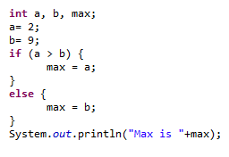
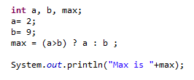
Conditional operator ? :
Alternative to if .. else. Also commonly known as the ternary operator (it takes three arguments) variable x = (expression) ? value if true : value if false
Boolean expression
Outcome of the statement if the boolean expression is true
Outcome of the statement if the boolean expression is true
An if .. else coded using the Conditional operator

Slide 12
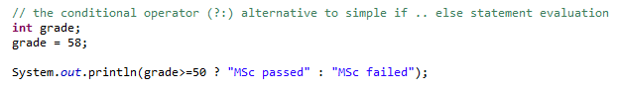
Conditional operator ? :
While it is possible to leave out braces if you have only one statement in loop or selection block it is recommended to surround all blocks with braces. Increases code readably, reduces logical errors, and ease of maintenance.
Notes:
Or
String status;
int grade = 59;
status = grade >= 50 ? "pass" : "fail";
System.out.println("Status is "+status);

Slide 13

The Switch statement
switch multiple-selection statement performs different actions based on the possible values of a constant integral expression of type byte, short, int or char or a String
Unlike if and if-else statements, the switch statement can have a number of possible execution paths
switch (expression) {
case condition1: code_block_1; case condition2: code_block_2; case condition_n: code_block_n; default: code_block_default; }
General format of a switch statement

Slide 14
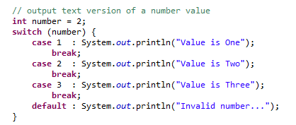
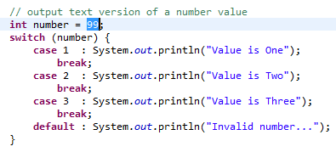
The Switch statement
Switching on an int value
The value is Two
Use of the default
Invalid number…

Slide 15

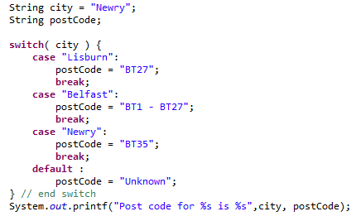
The Switch statement
Switching on a String value
Post code for Newry is BT35

Slide 16
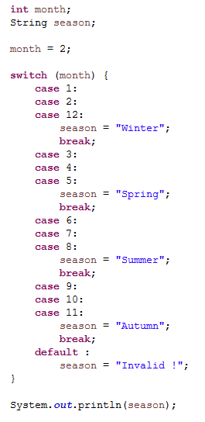

The Switch statement – fall through
Each break statement terminates the enclosing switch statement. Control flow continues with the first statement following the switch block.
The break statements are necessary because, without them, statements in switch blocks fall through:
All statements after the matching case label are executed in sequence, regardless of the expression of subsequent case labels, until a break statement is encountered.
Winter

Slide 17




Exercise IV: switch
Create an application that when given the month of the year i.e. 1 to 12 as input will output the semester i.e. 1, 2 or summer.
Rules
Months 9, 10, 11, 12 and 1 : Semester 1
Months 2, 3, 4 , 5 : Semester 2
Months 6, 7, 8 : Summer
Hints : create a var (int) for the month.
“I do believe it's working, good. That'll keep you going through the show Come on it's time to go…”
Now add a Scanner to enhance the interactivity of the program. i.e. prompt the use for the month.
Input Output 1 Semester 1 10 Semester 1 3 Semester 2 8 Semester 8 13 Invalid -999 Invalid
Exhaustive && exhausting?
Notes:
Exercise iV solution :
int month =4;
switch (month){
case 1: case 9: case 10: case 11: case 12:
System.out.println("Semester 1");
break;
case 2: case 3: case 4: case 5:
System.out.println("Semester 2");
break;
case 6: case 7: case 8:
System.out.println("Summer");
break;
default :
System.out.println("Invalid");
}

